Slide 1
GPS-Denied Geo-Localization using Visual Odometry
Ashish Gupta
gupta.637@osu.eud
Huan Chang
1984chang@gmail.com
Alper Yilmaz
yilmaz.15@osu.eud
The Ohio State University

Slide 2
Outline
GPS-denied Geo-Localization
Current approach and Issues
Our Approach
Methodology
Visual Odometry
Graph Search
Results
Discussion & Future Work

Slide 3
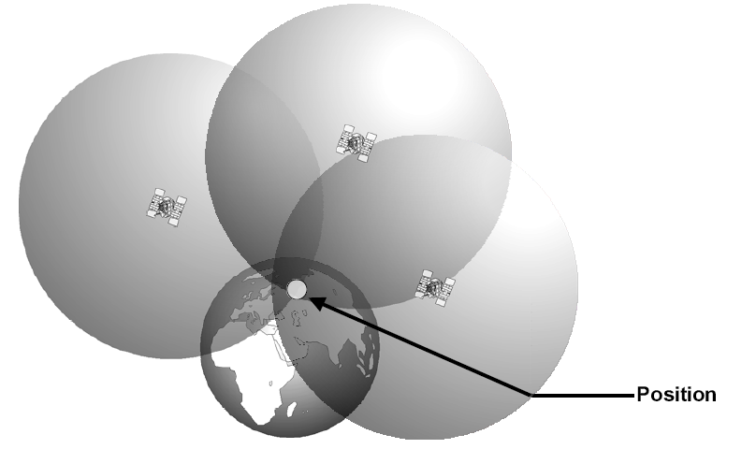
GPS available Localization
Triangulation using multiple satellites
Notes:
Requires lines of sight and

Slide 4
Issues in GPS-denied or degraded localization
Requires line-of-sight with multiple satellites
Unreliable in urban canyons, indoors, underground, etc.
Draws battery power quickly
Commercial GPS have limited accuracy

Slide 5
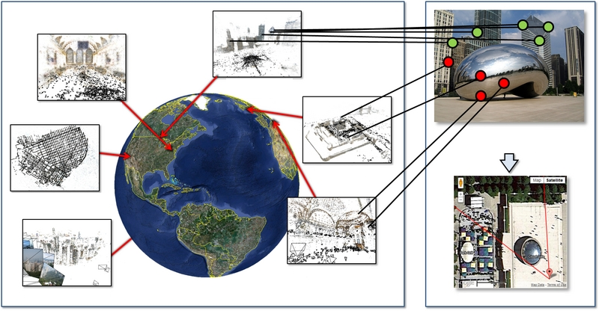
GPS-denied: current approach
Recognize geo-tagged landmarks in an image to infer geo-location of query image from a database of geo-tagged landmark images.
Notes:
Content Based Image Retrieval of geo-tagged images.

Slide 6


Issues with geo-tagged retrieval
Computational complexity
Communication requirement
Spatial scalability
Lacking Topology
6
Notes:
High computational cost of image matching in large database. Requires communication of multi-media, which itself requires high data bandwidth. Greater the potential search region, greater the computational complexity. Provides approximate geo-position, but not accurate and does not account for direction of distance since it lacks any topological information of that geographic region.

Slide 7


Our Approach: underlying idea
Real-time Geo-Localization
+
Local, Dynamic, Position Estimation
Global, Static, Location Information

Slide 8
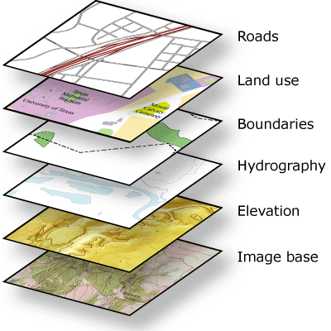
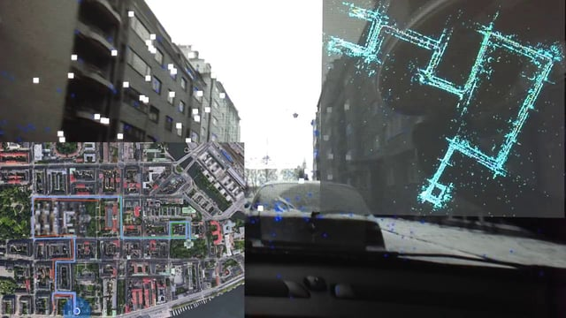
Our Approach: alternate sensors
Localization
GPS
GPS-Denied
Alternate Sensors
Visual: Camera
Inertial: IMU
Transceiver
Geographic Information System
Visual Odometry
Notes:
Relative position. Mobile platform refers to hand held camera on automobile, UAV, boats

Slide 9
Our Design Objectives:
Resource efficient processing
Mobile platforms
No data communication
Standalone mode
Offline GIS
Independent of spatial priors
Indoor/outdoor, urban/rural, county/country, etc.
Independent of map sparsity
Relies on map topology
Capable of exploiting GIS layers
Transport, hydrology, relief, etc.

Slide 10
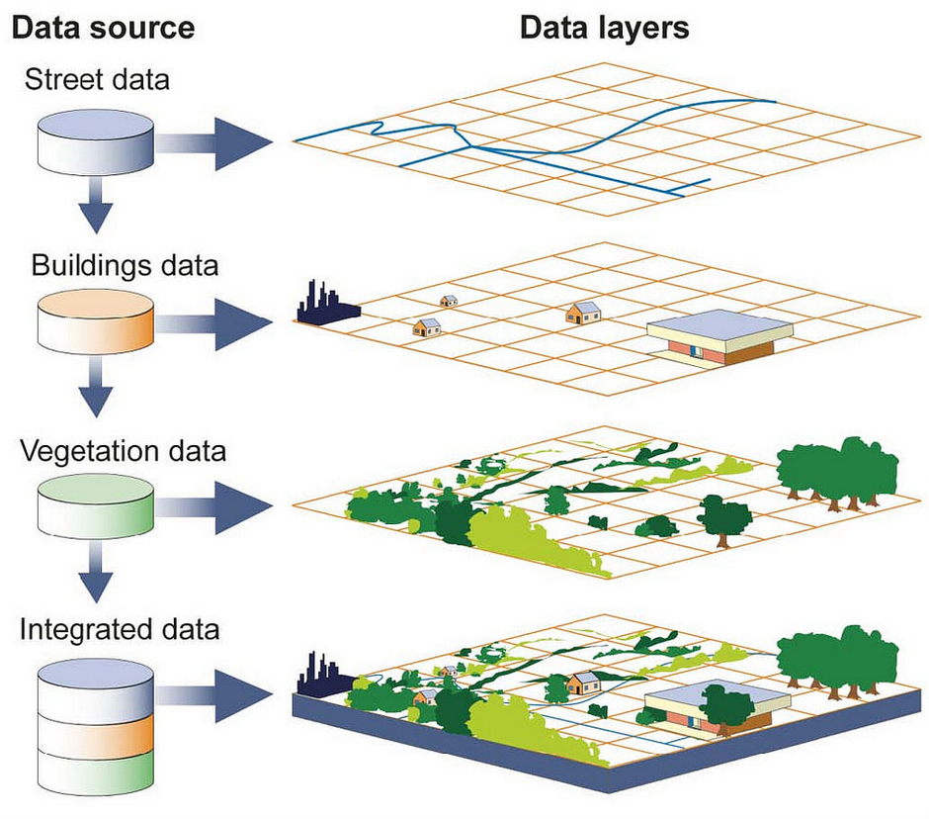
Geographic Information System (GIS)
GIS is continuously growing geo-information repository
Different layers provide complementary feature topology
Geo-info in separate layers that can be integrated
Notes:
Current focus on ‘road network’ layer using public domain databases like ‘Open Street Map’

Slide 11
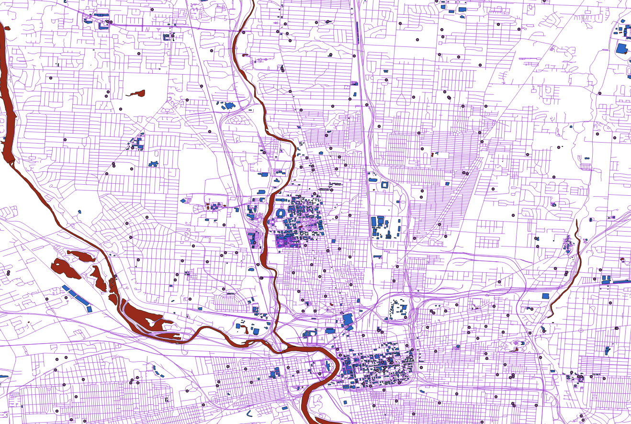
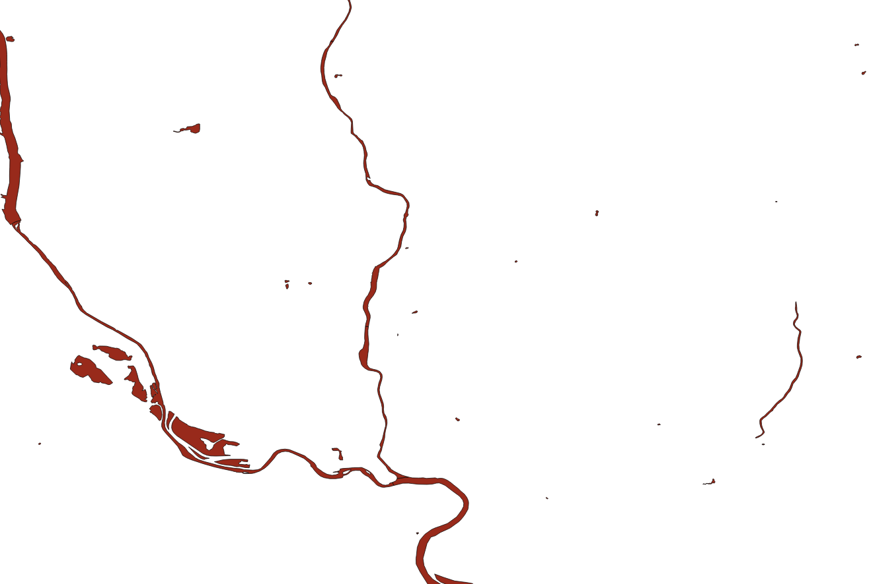

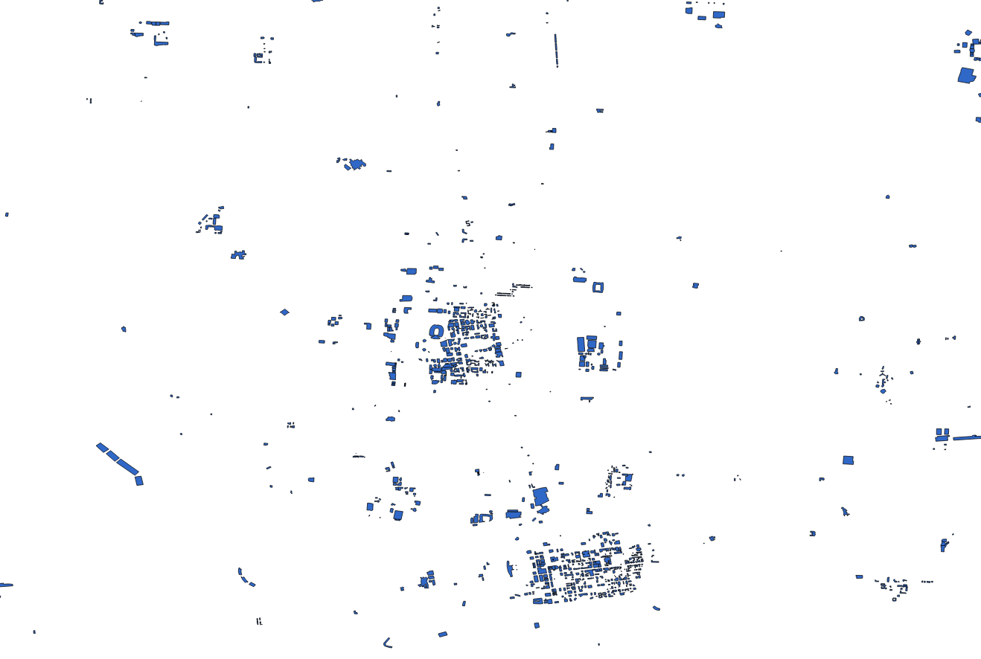
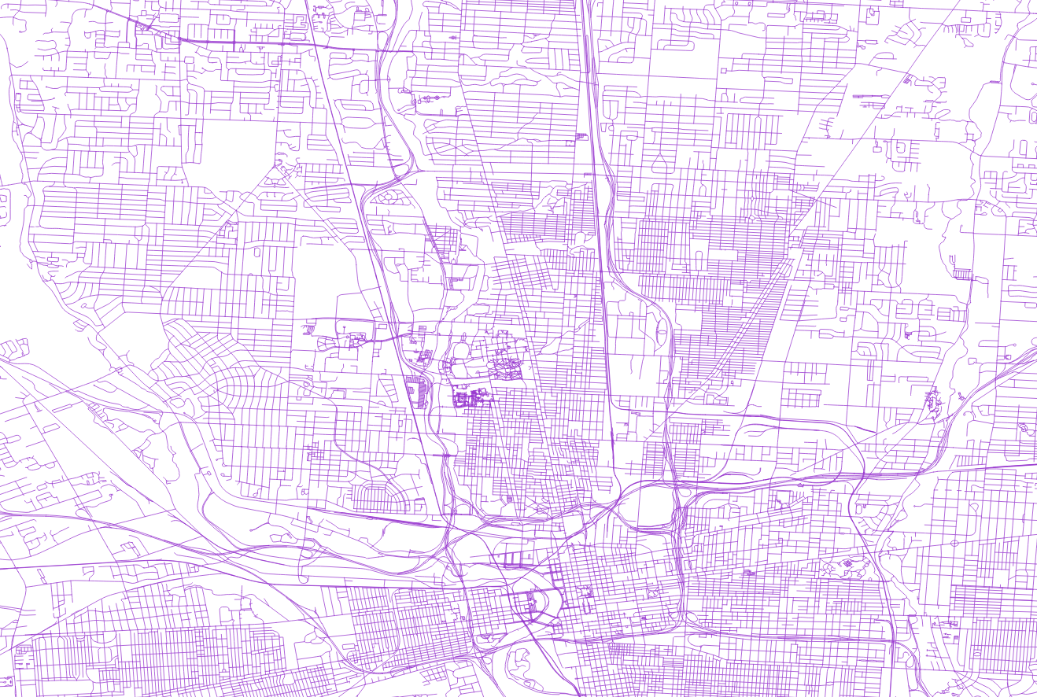
Example: GIS Layers in Columbus, Ohio, United States
waterways
amenities
buildings
roads

Slide 12
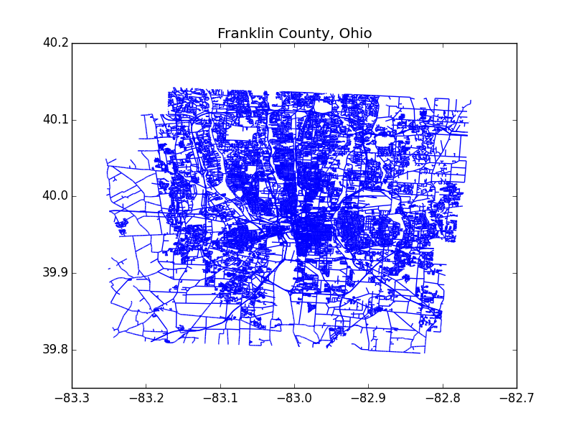
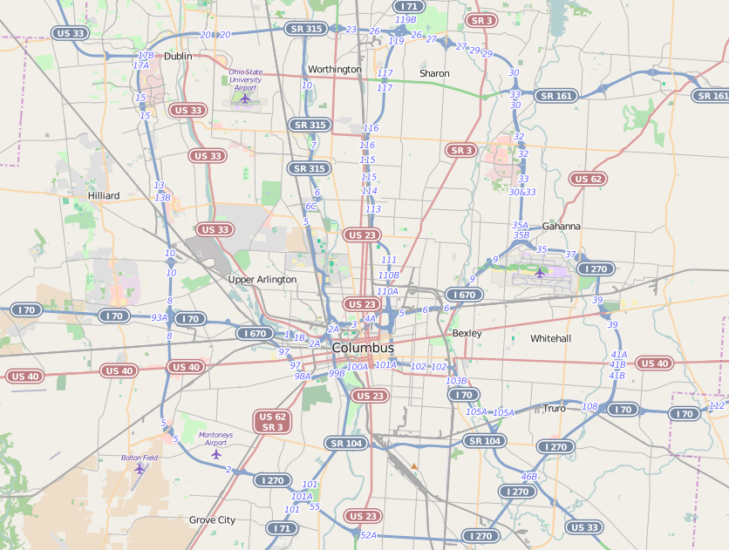
GIS abstraction to Graph
Map → Graph
Data is noisy: registration, position
Missing data: connectivity, intersections
Automated map preprocessing and restoration

Slide 13
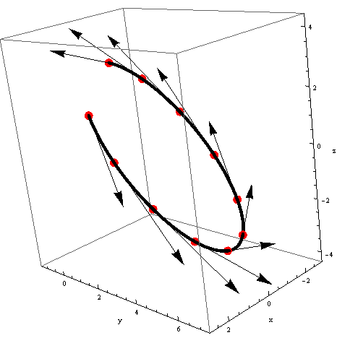
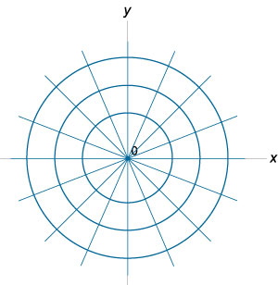
Encoding Real-time Trajectory
Visual Odometry is used to estimate trajectory in real-time
Encode trajectory in quantized polar coordinates

Slide 14
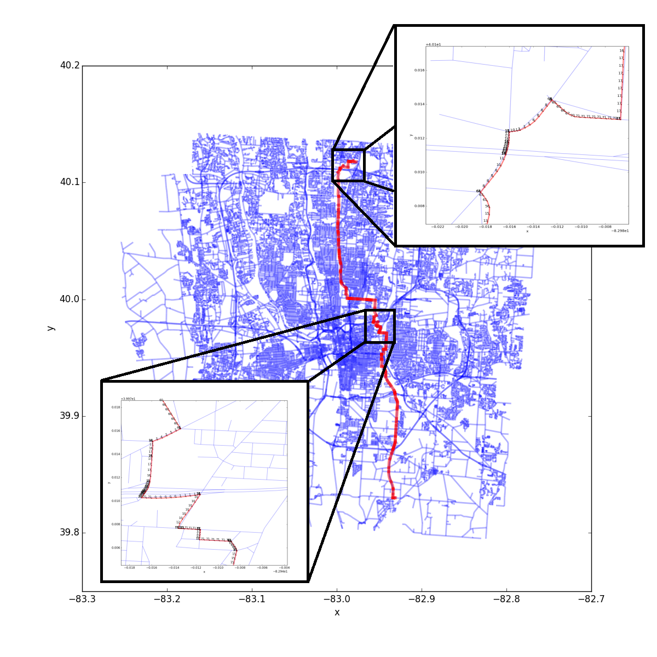
Encoding Graph Traversal
Graph-edges (Road) descriptors along a trajectory

Slide 15
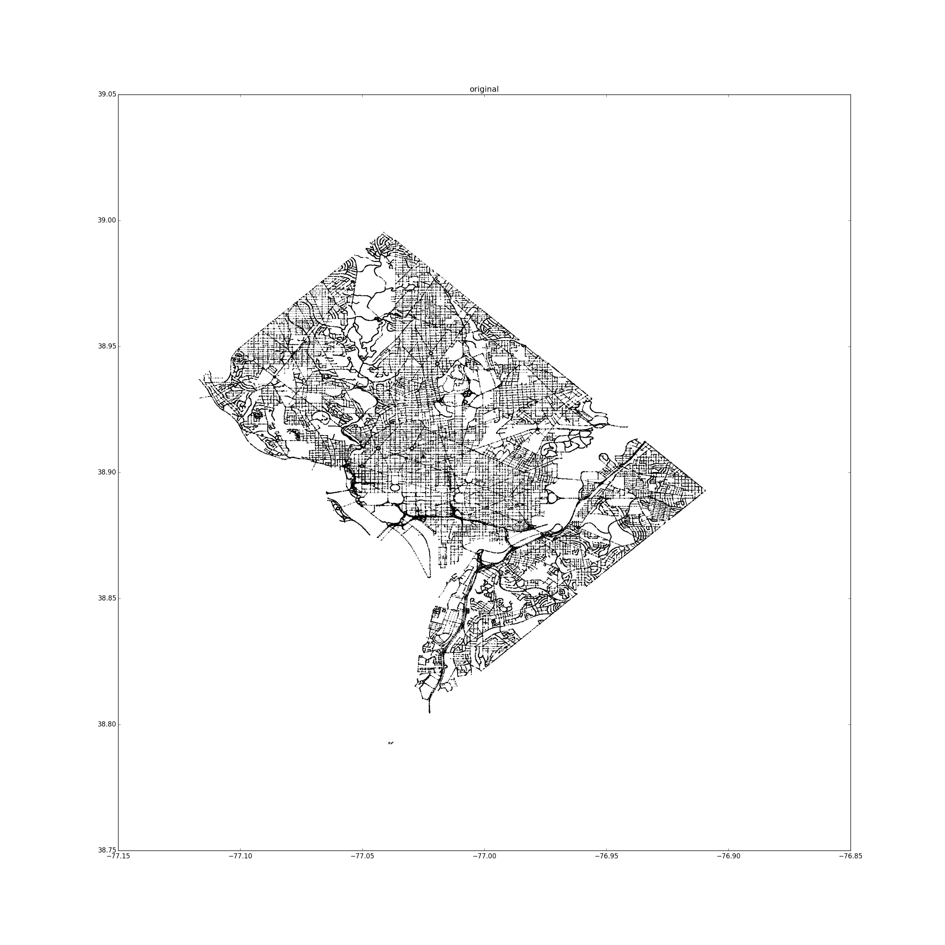
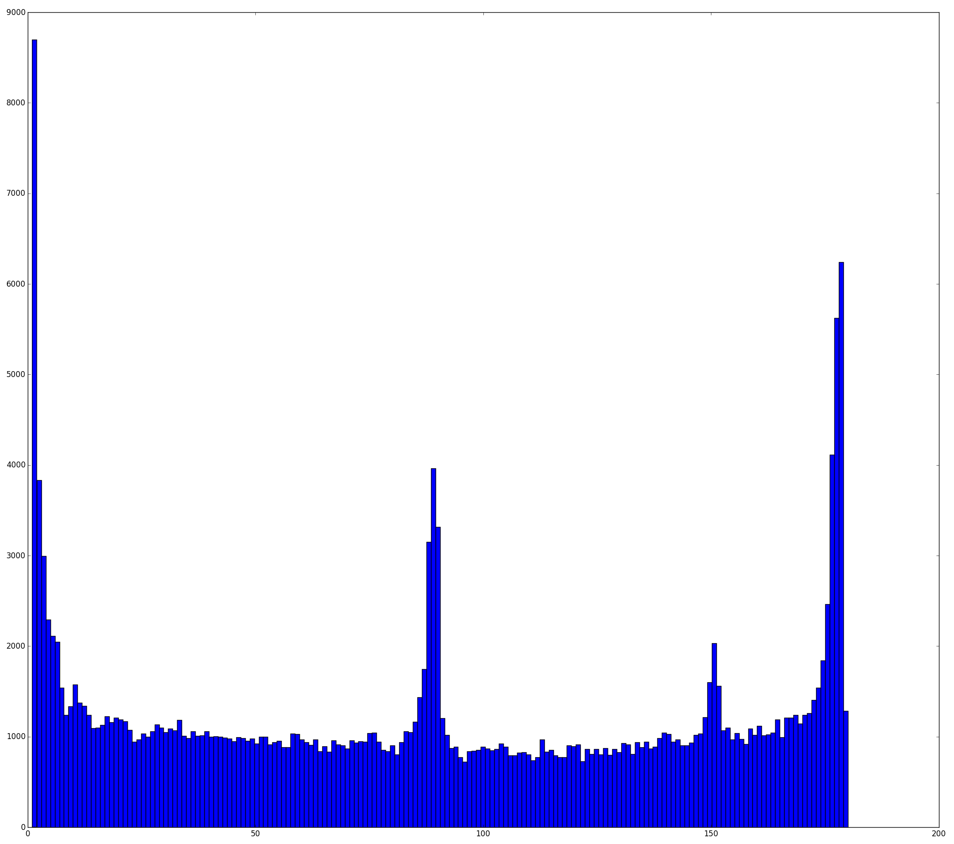
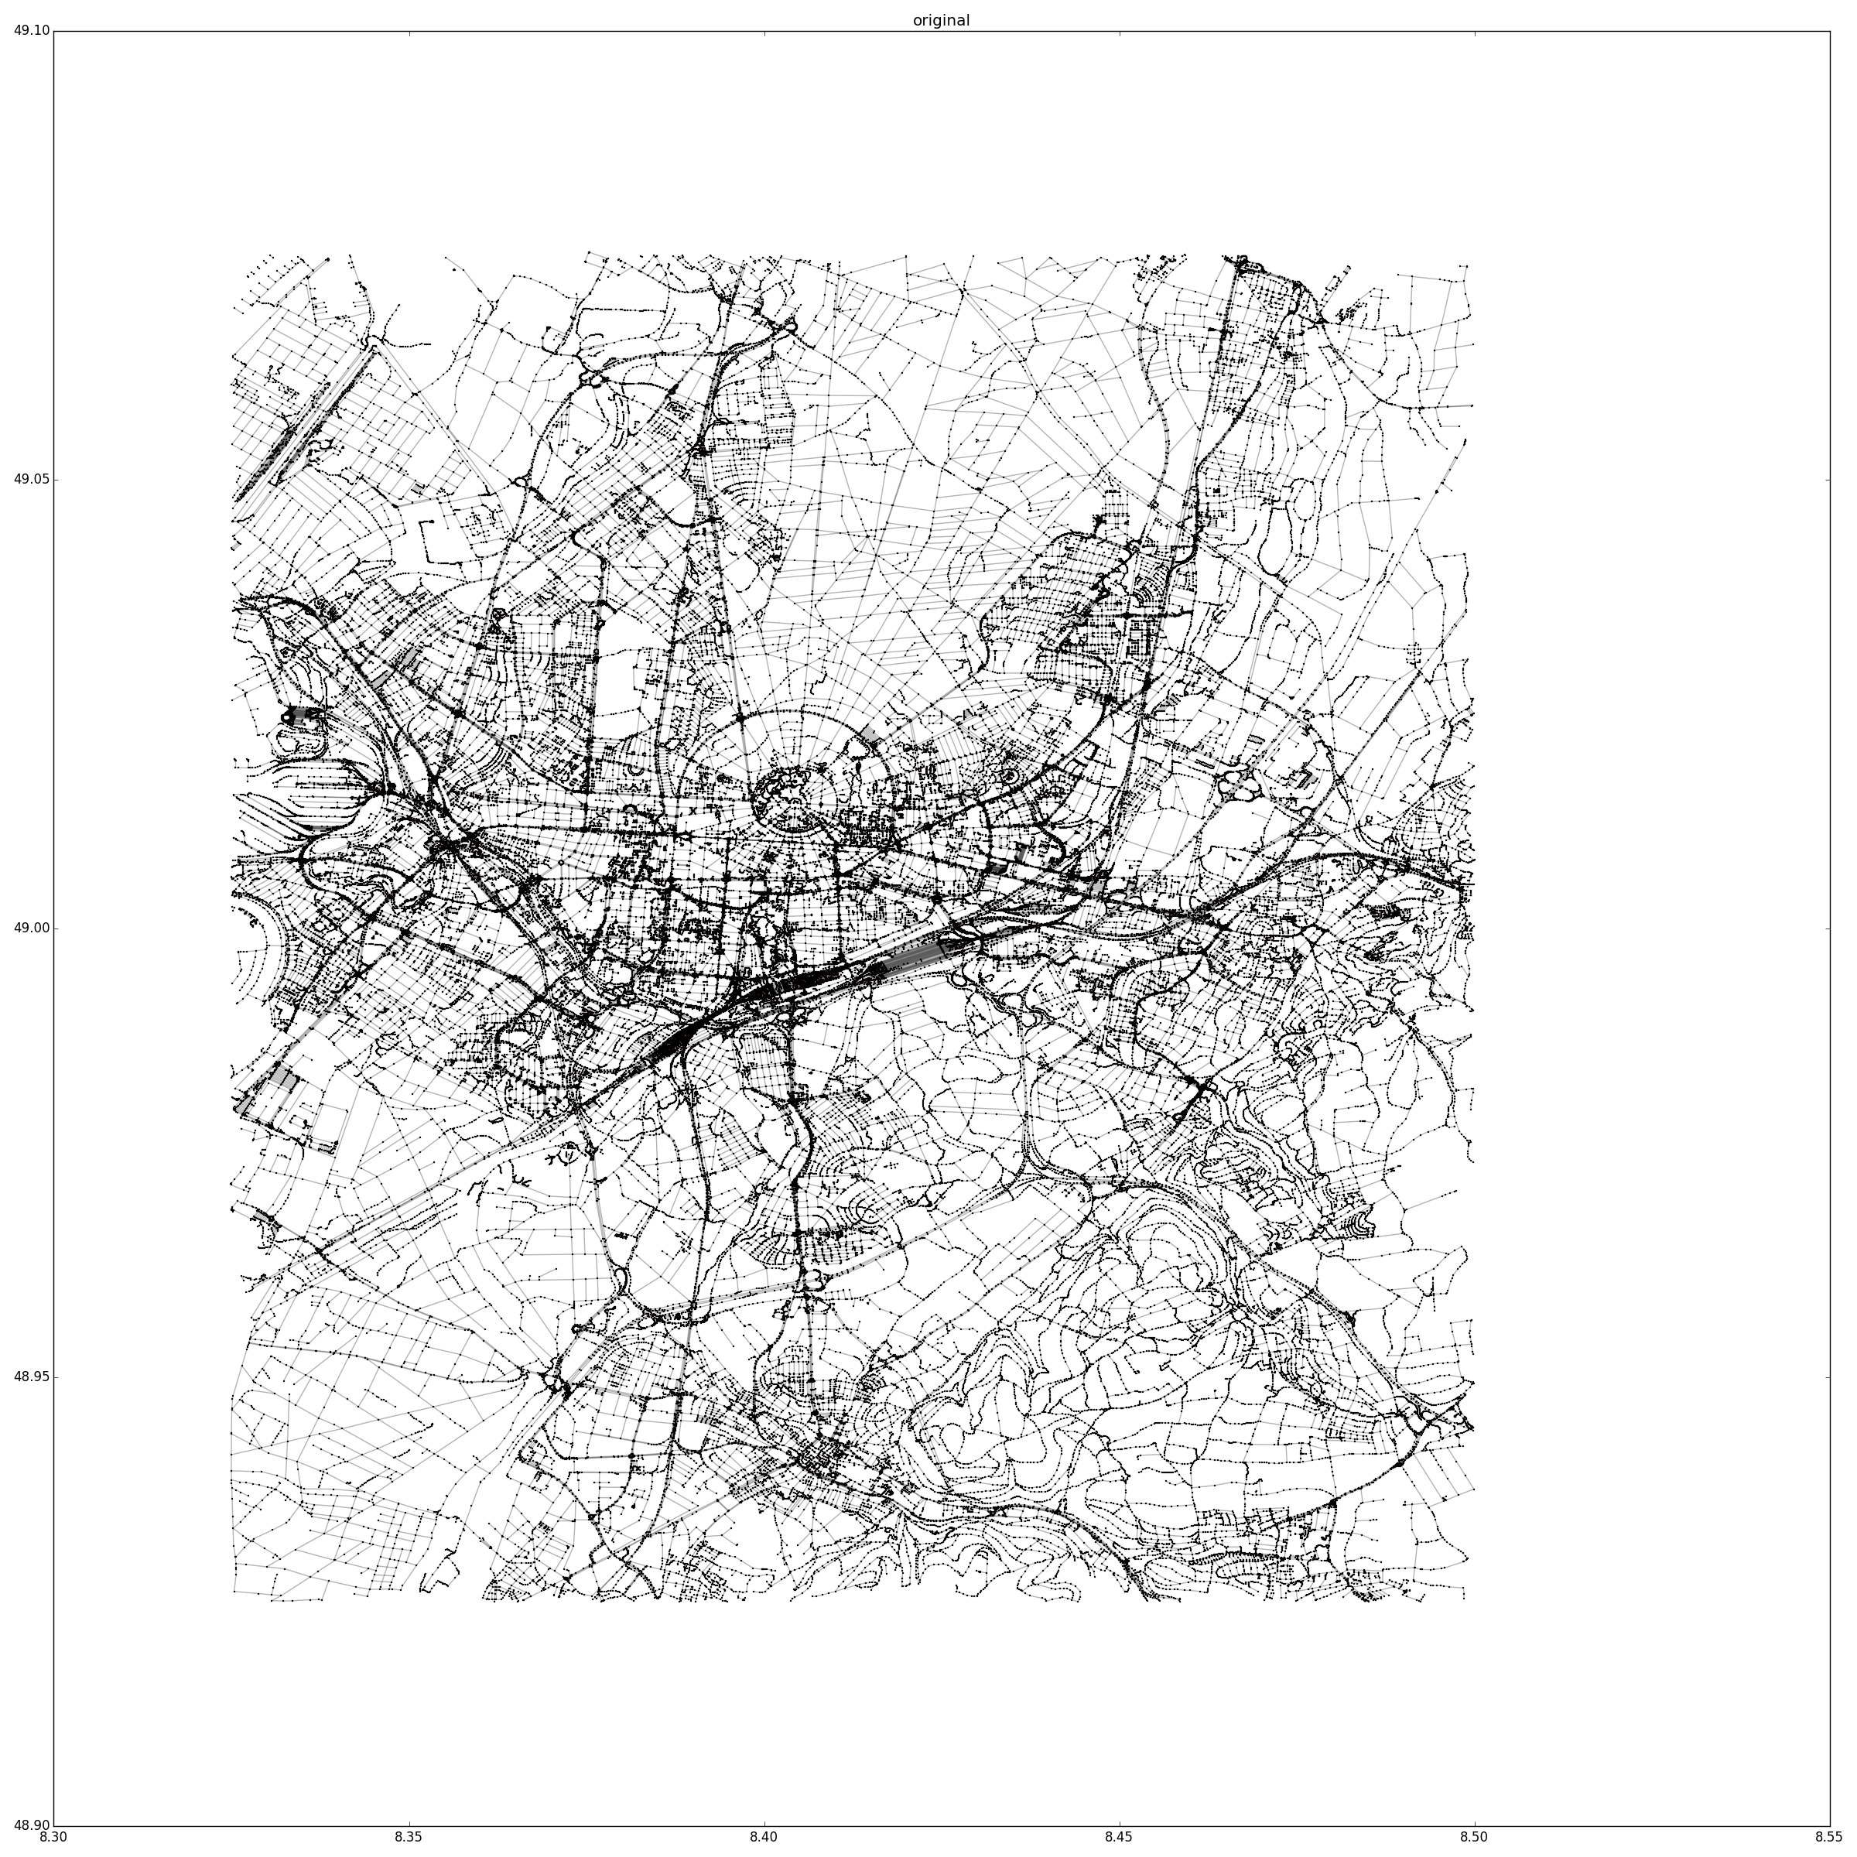
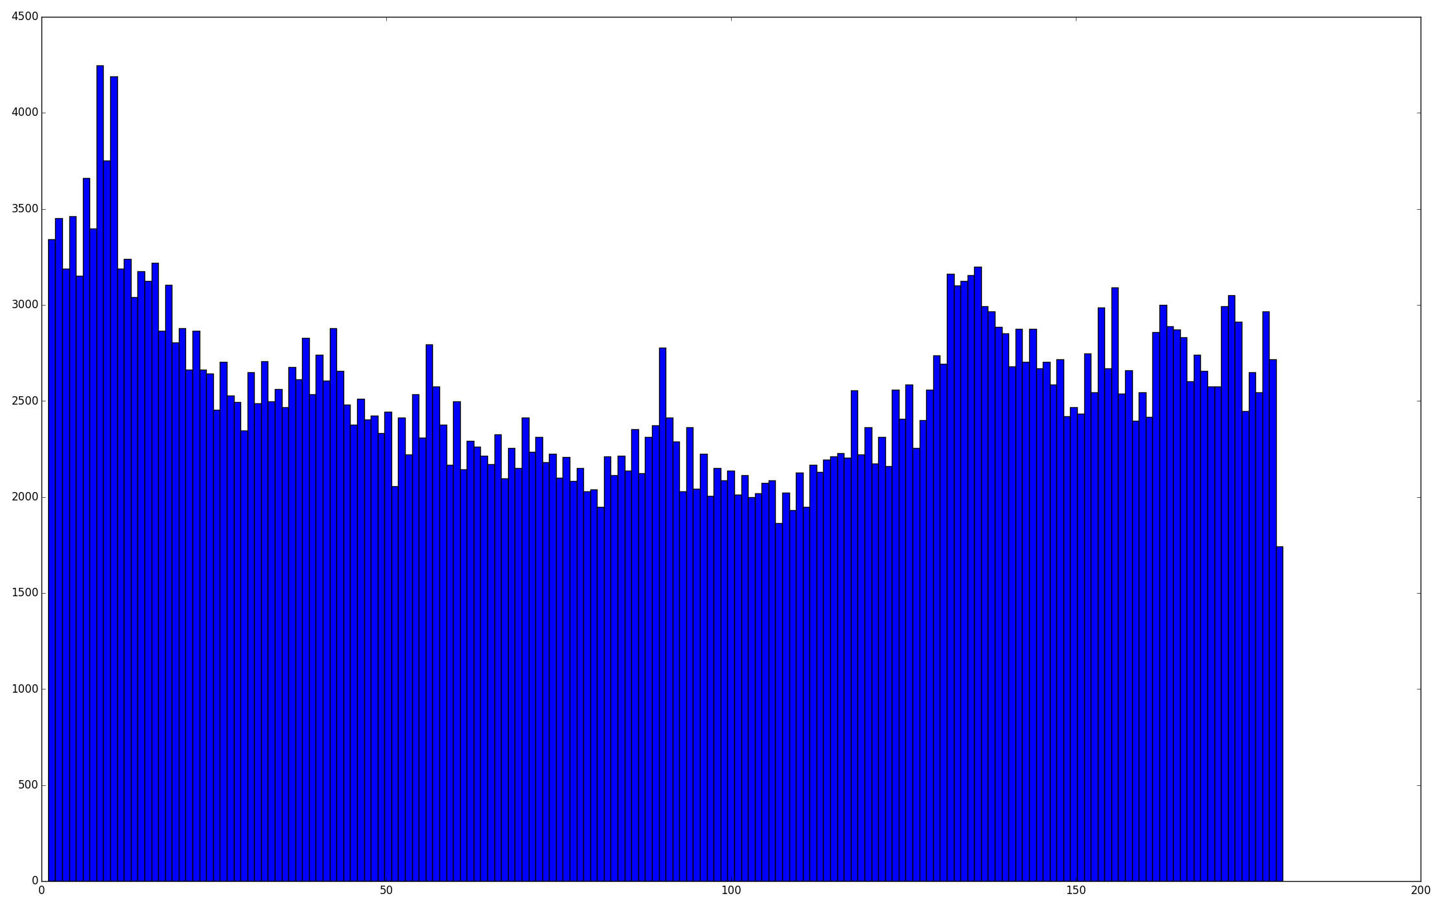
Encoding Feature Choice
Washington DC county map
Histogram of road orientation changes
Karlsruhe, Germany map
Histogram of road orientation changes
Notes:
Lattice structure urban roads vs. fibrous suburban and rural roads. Histogram shows frequency of occurrence of orientations changes from 0 to 180 degrees

Slide 16
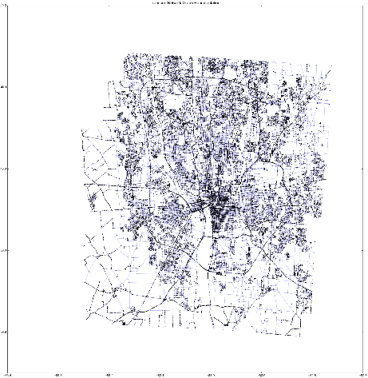
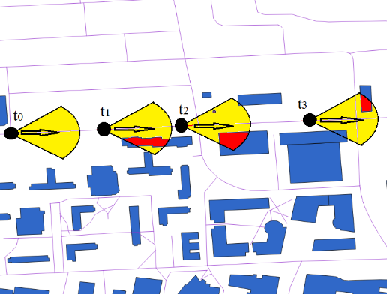
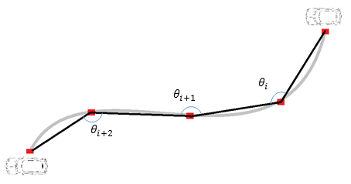
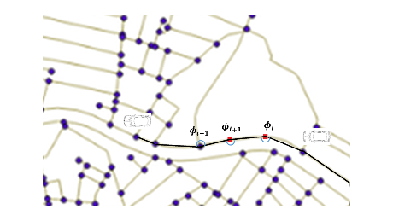
Localization: Search for matching Trajectory & Graph Traversal
Platform Trajectory
Graph Traversal

Slide 17
Methodology
Visual Odometry
Graph Search

Slide 18
Visual Odometry
IMU data
Camera frames
IMU and Camera Calibration
Data Synchronization
Feature tracking
Initial State
Noise and Filter Parameters
State and covariance propagation
Triangulation
Kalman filter
Camera pose

Slide 19
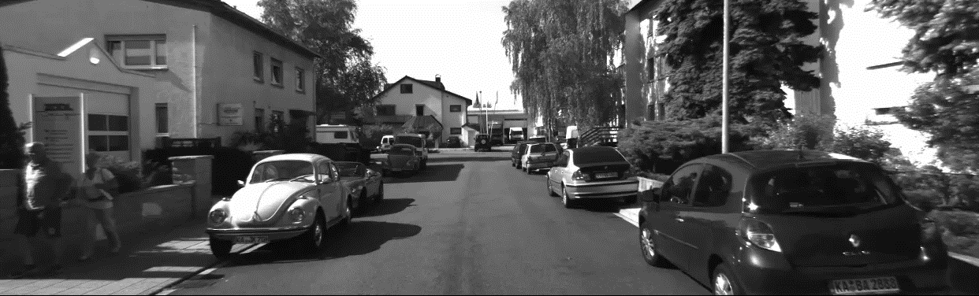
Mobile platform camera view

Slide 20
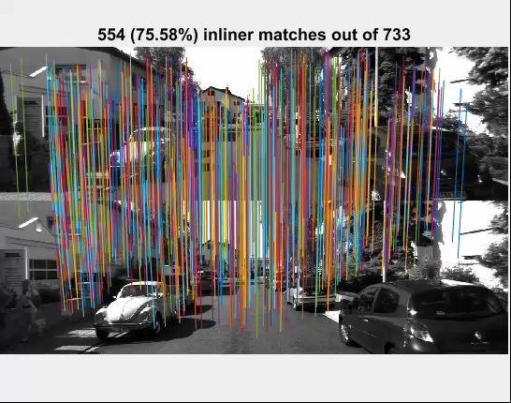
DSP Sift based correspondences

Slide 21
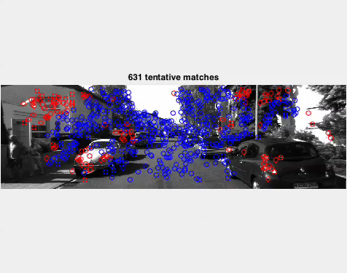
Geometric Inlier Outlier Sets

Slide 22
Evaluation of 3D trajectory

Slide 23
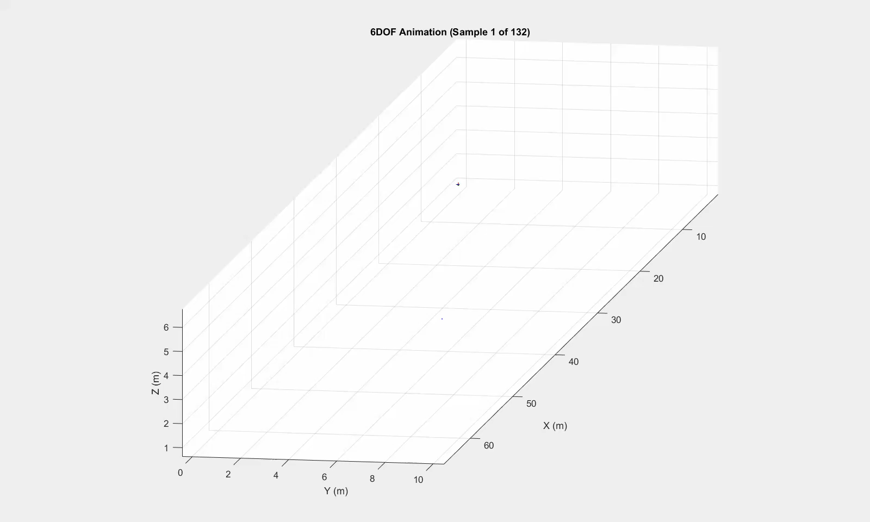
Recovered 3D Trajectory

Slide 24
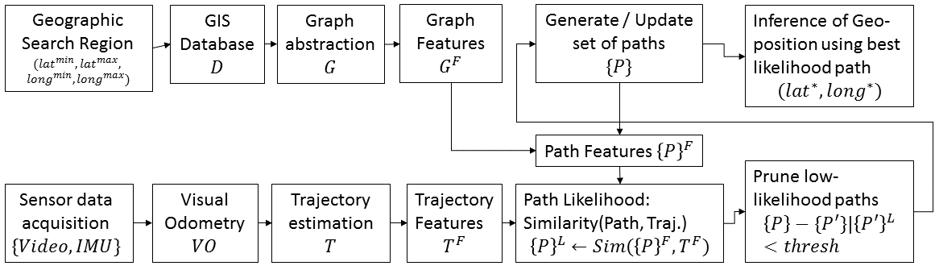
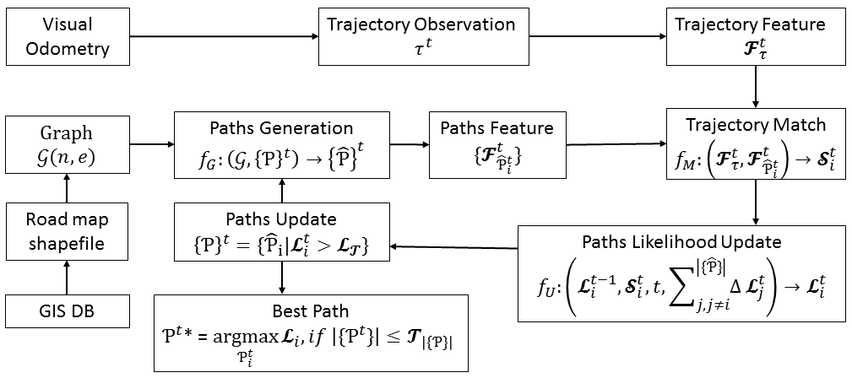
Algorithm: graph search
Comparing Trajectory & Traversal
Spawning & Pruning matching traversals

Slide 25
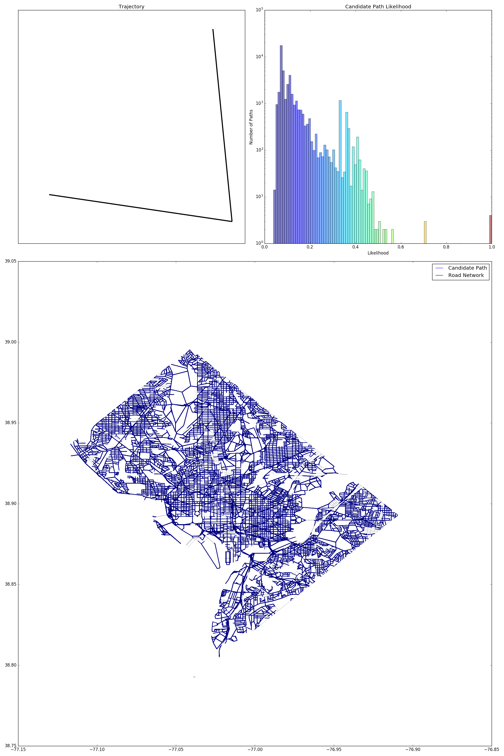
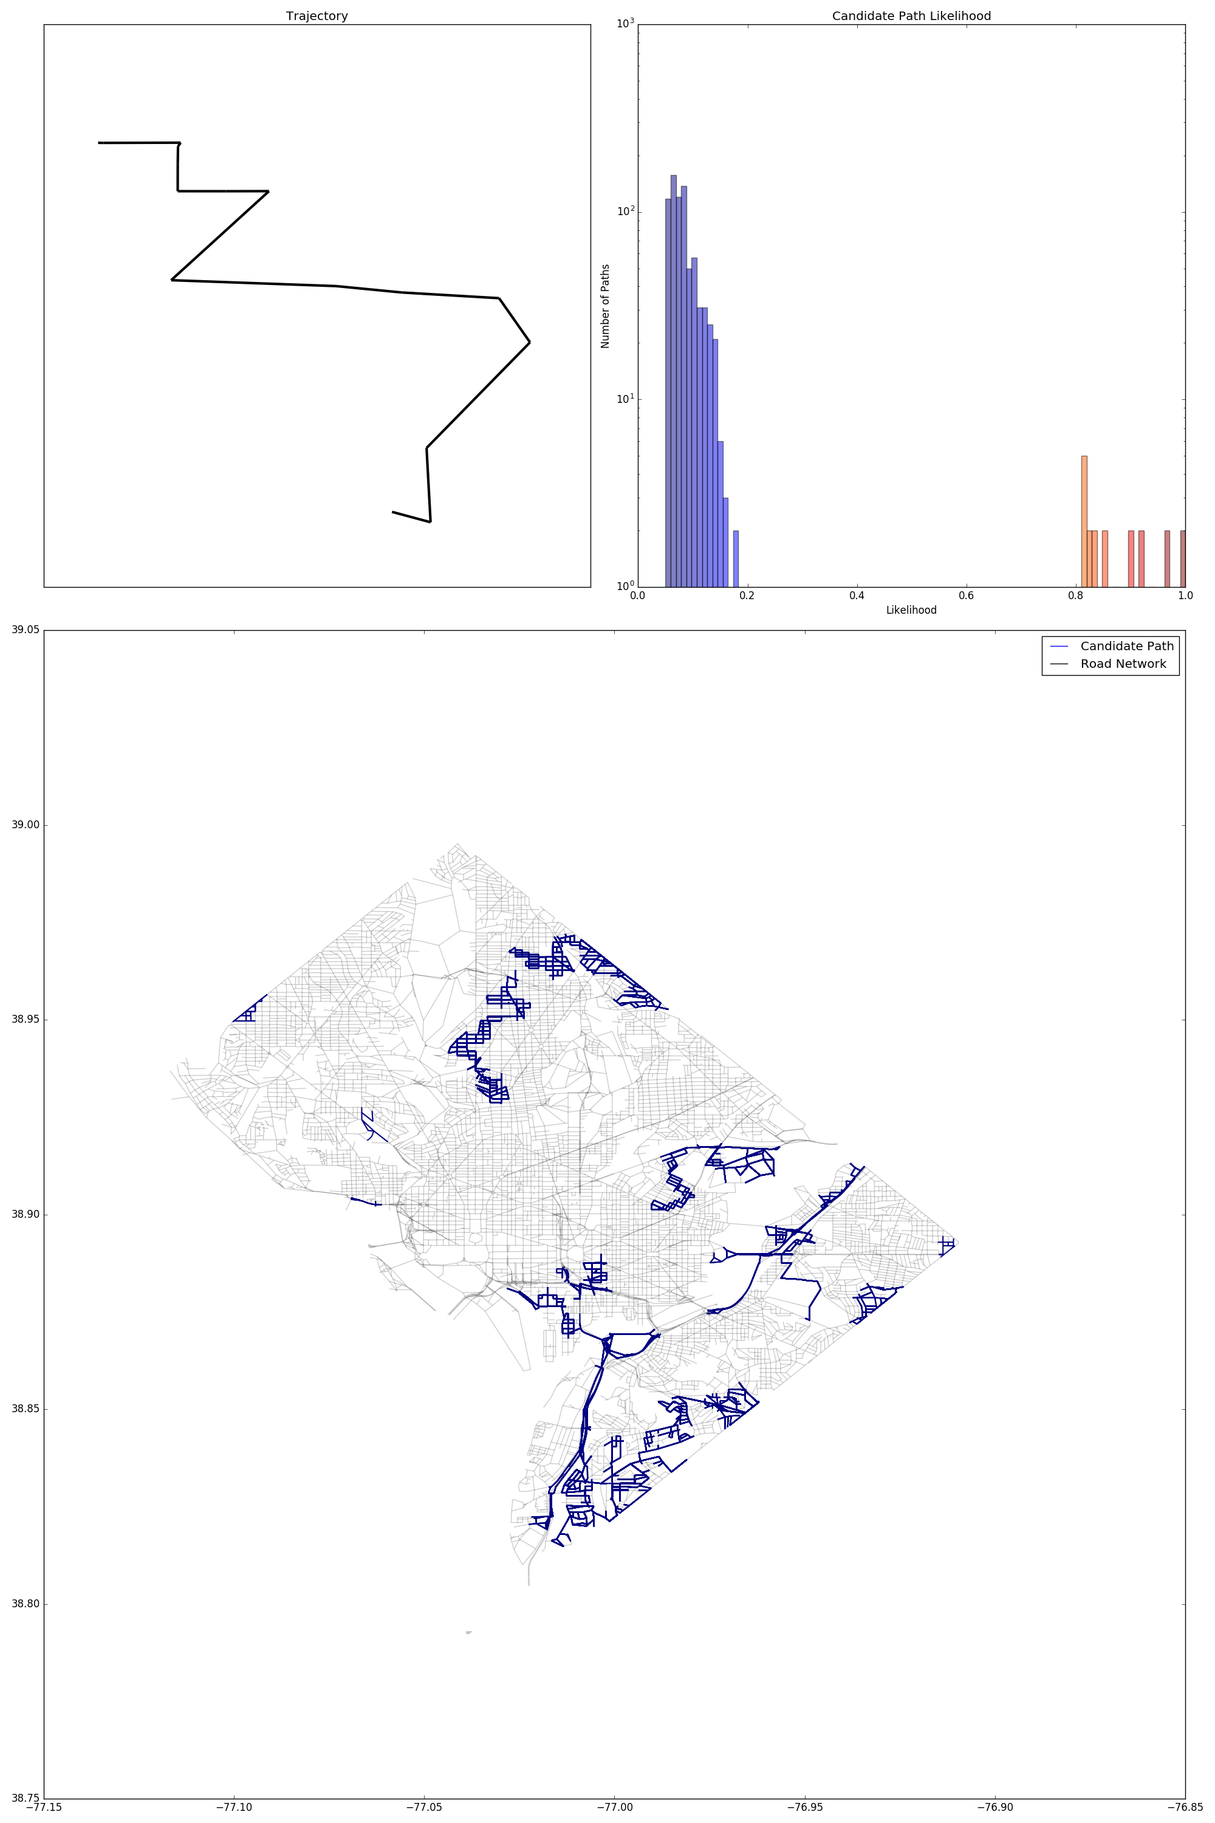
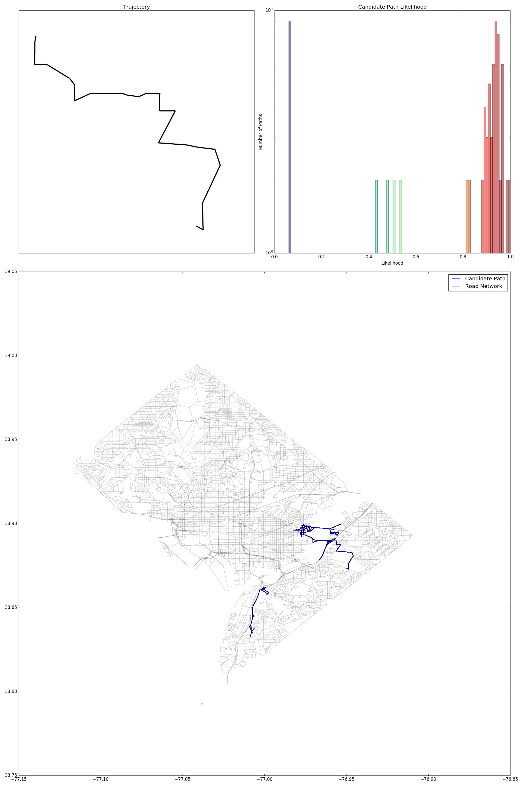
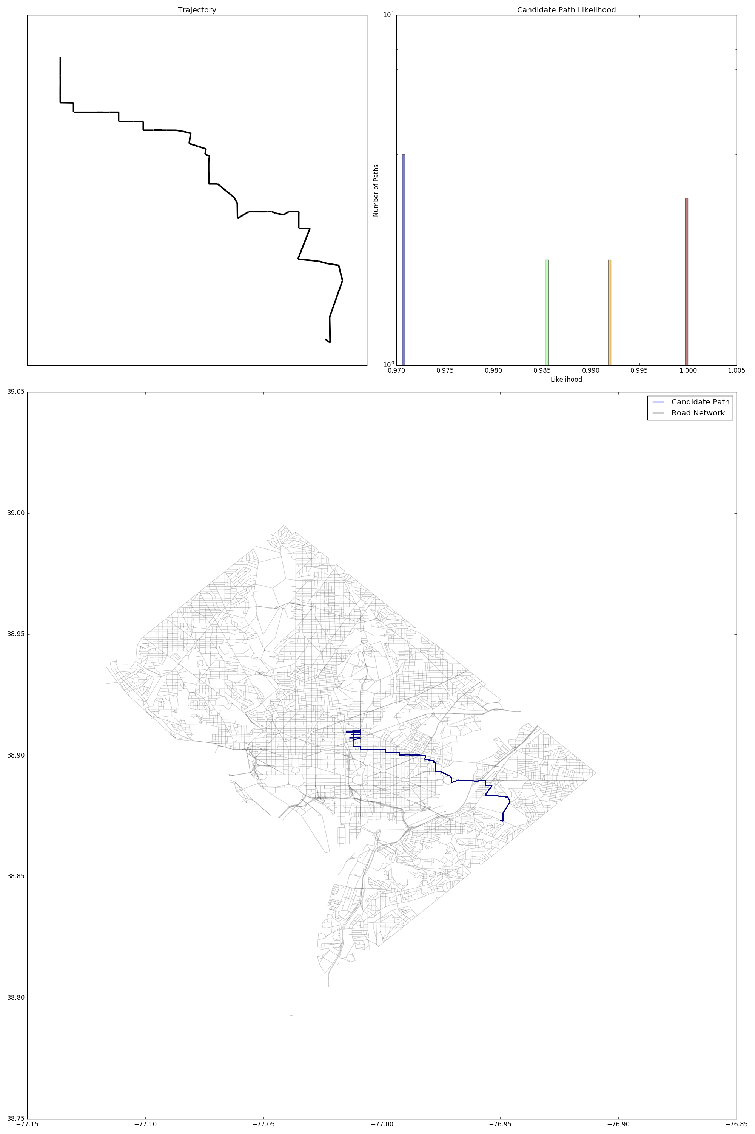
Key idea: Progressive Localization
Our probabilistic framework is designed to be robust to errors in both estimated trajectory and available map as we progressively find the actual traversal in map and thereby the Geolocation.
Notes:
Top left shows trajectory. Histogram on top right shows the likelihood score of each candidate path, bottom map shows current candidate paths.

Slide 26
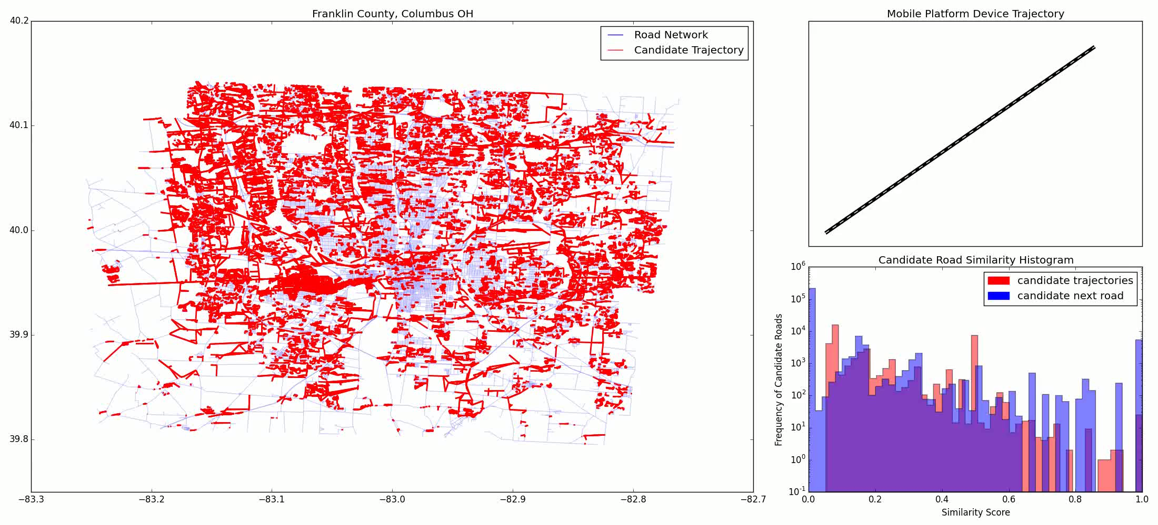
Progressive Positioning and Prediction
County map Columbus, Ohio
Modeled with 50K nodes and 65K edges
Combination of urban and suburban roads.

Slide 27
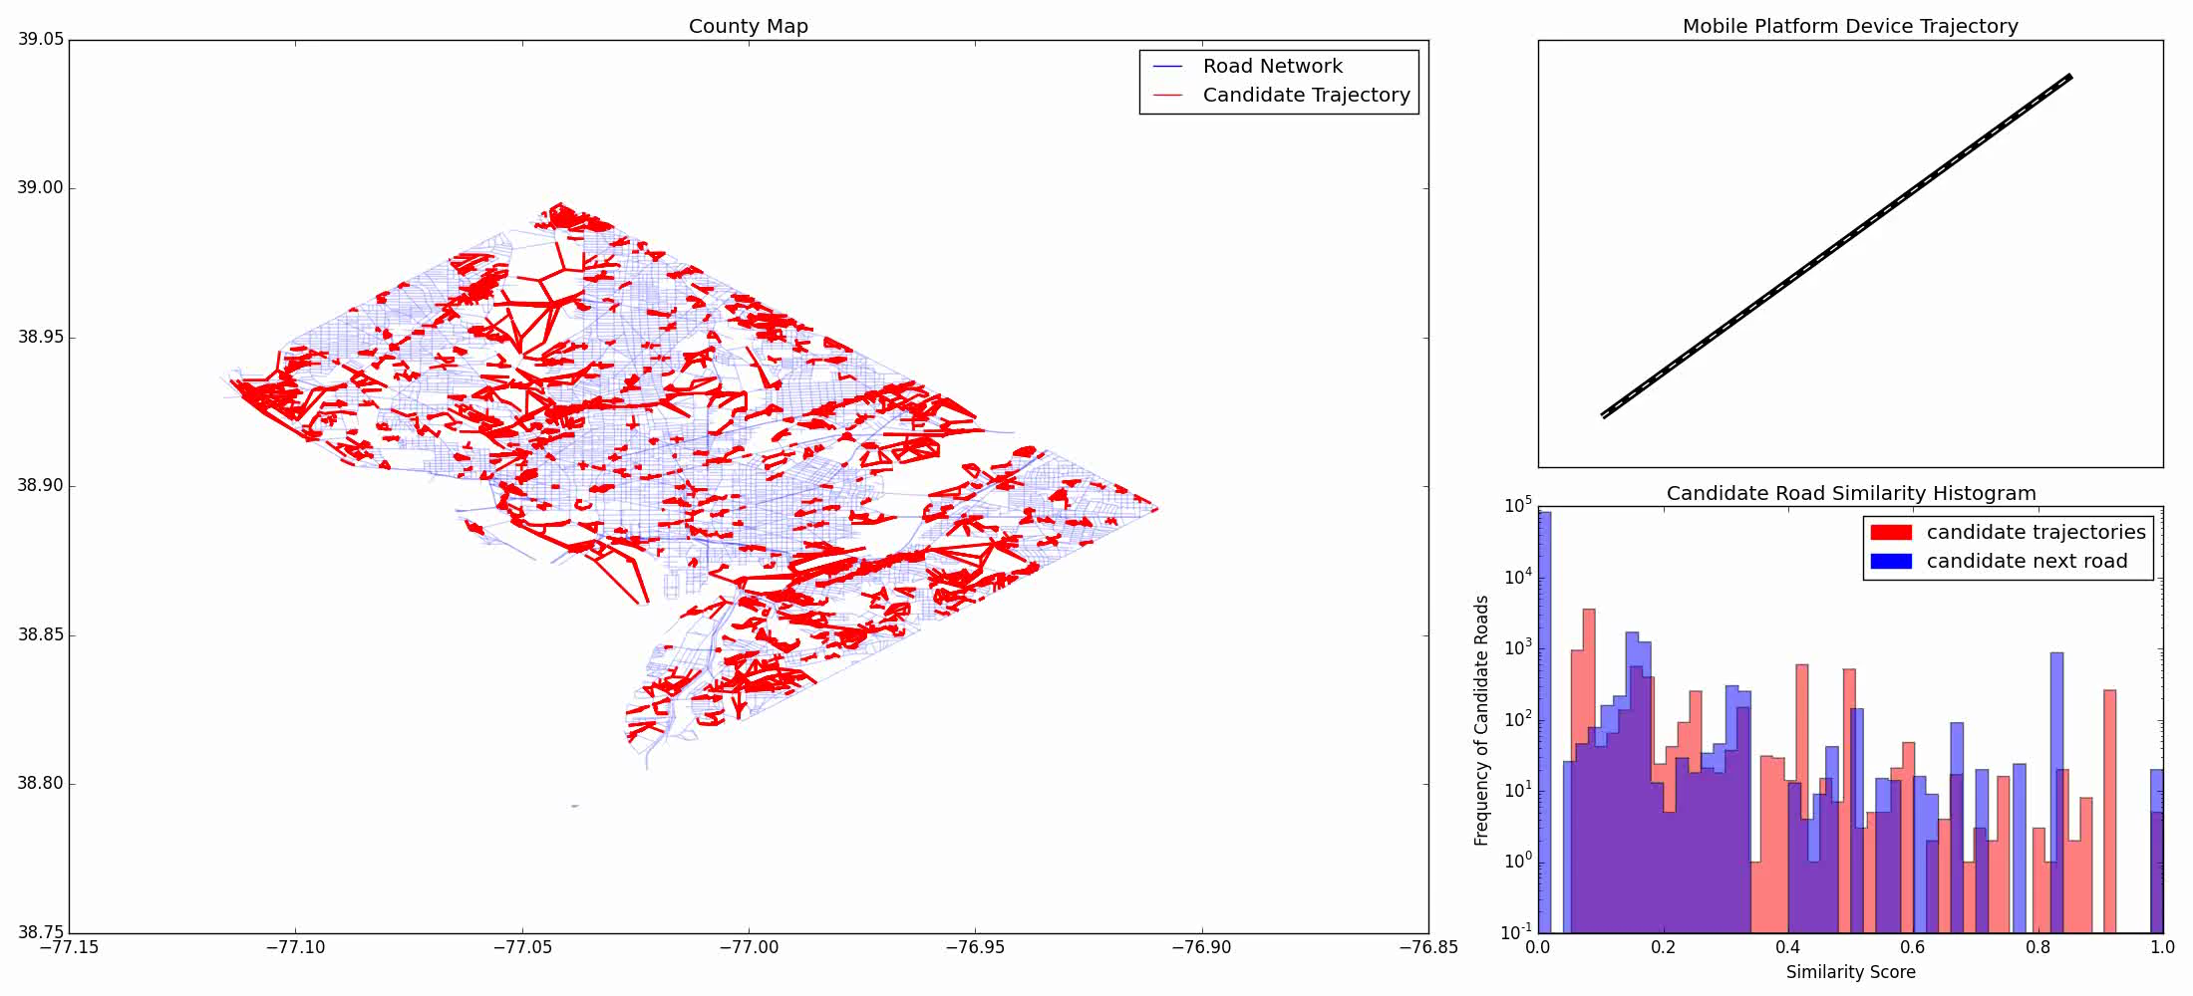
Trajectory Localization, Washington DC
Washington DC
Graph with 14K nodes and 20K edges
Roads are mostly regular lattice structured urban.

Slide 28
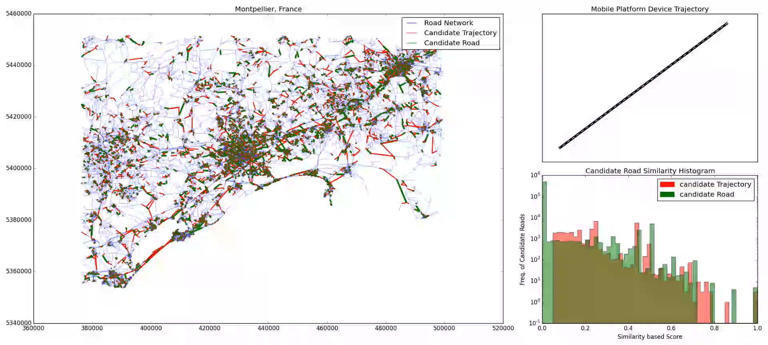
Localization, Large region
Map of Montpellier area, France
Graph with 104K nodes and 137K edges
Urban and rural roads with fibrous structure

Slide 29
Future Work
Integrate GIS layers
Combine buildings, vegetation, terrain GIS layers with transportation layer for navigation.
Create “transportation network” for rural areas using non-transportation layers of GIS, by estimating navigable paths
Extend and improve Indoor Positioning System

Slide 30
Questions…

Slide 31
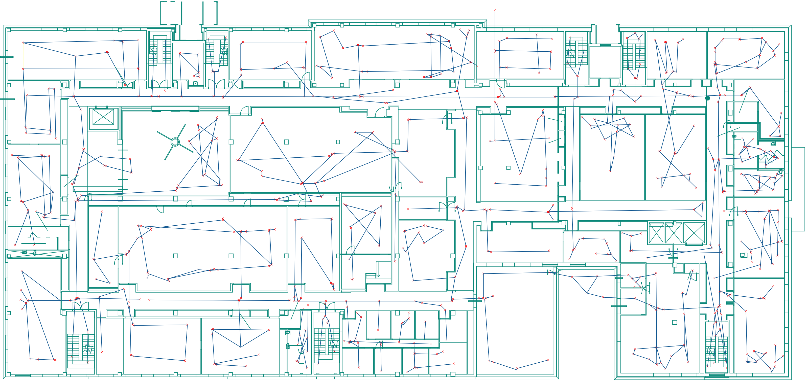
Extension to Indoor Navigation
Indoor modeled using trafficable routes
Architectural elements, furniture, utility objects create different traffic routes.

Slide 32
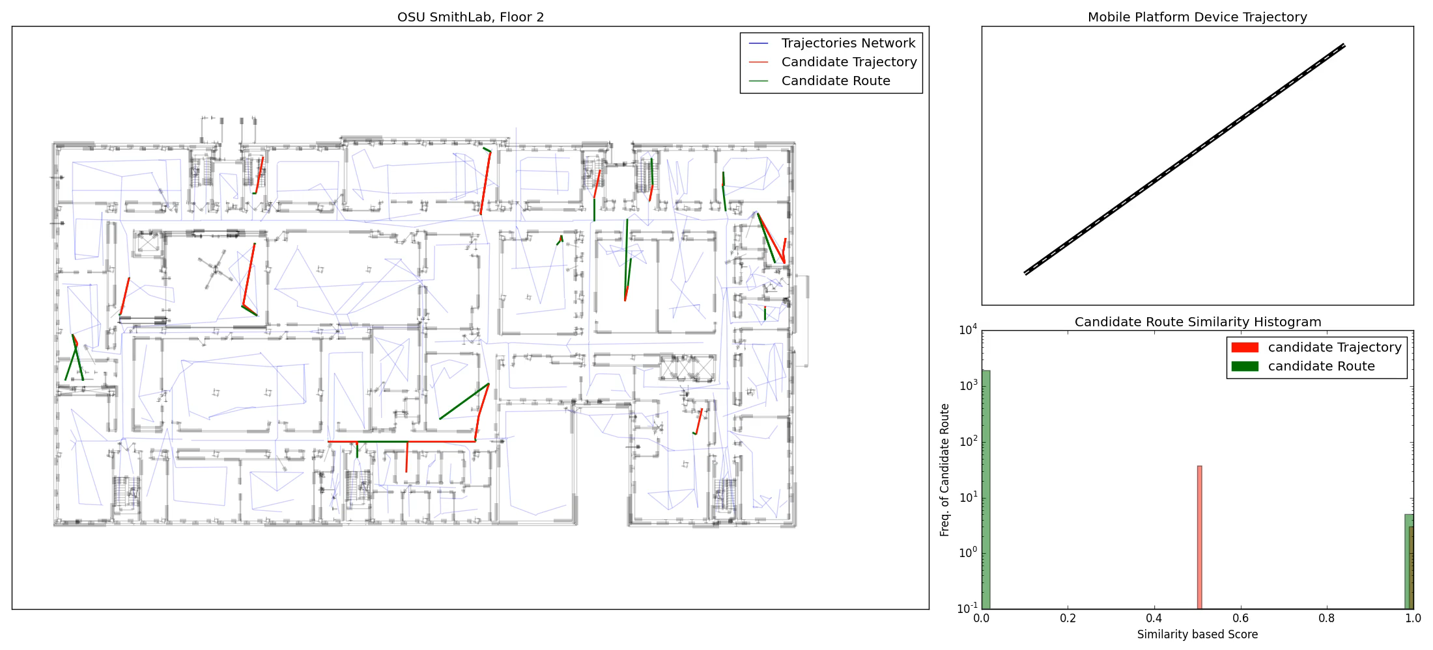
Extension to Indoor Navigation
Smith Lab 2nd floor, OSU
Modeled using 600 nodes and 350 edges
Routes shapes are related to room organization, and location of obstacles and other objects

